Slide 1
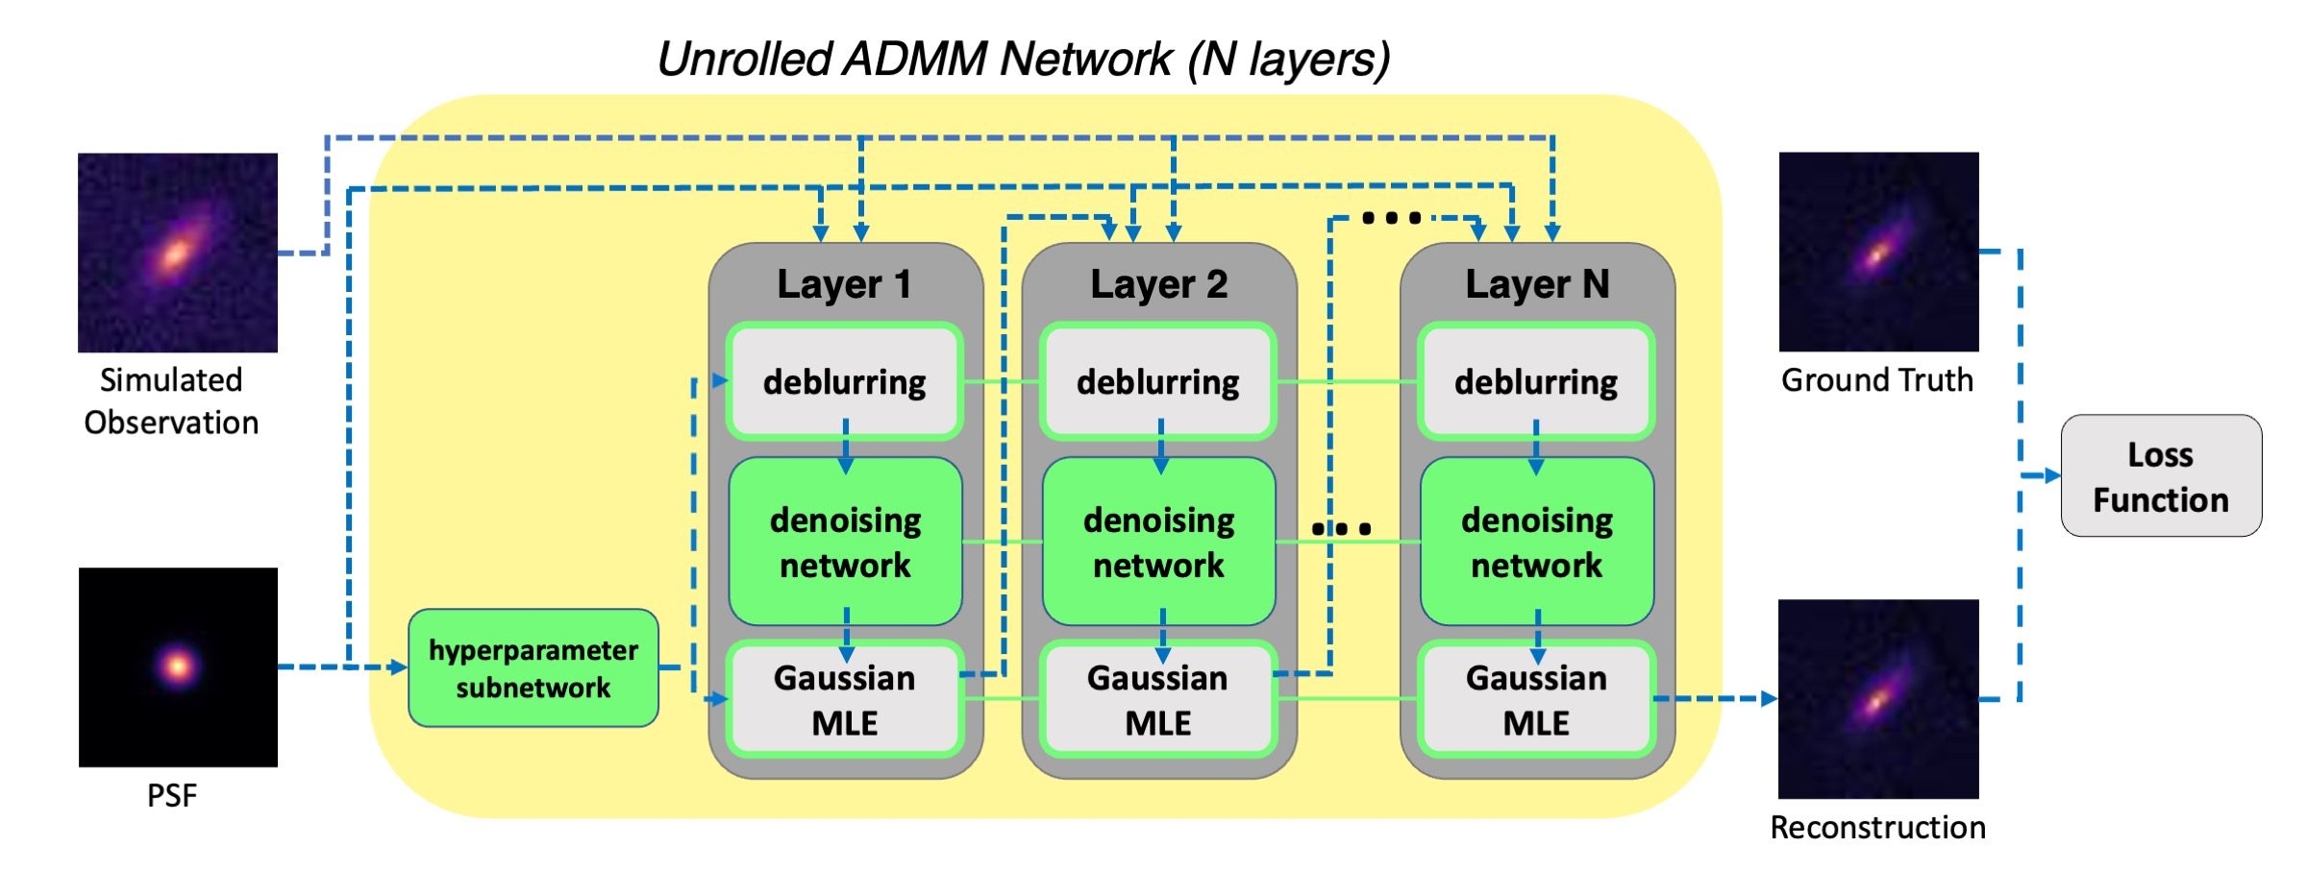

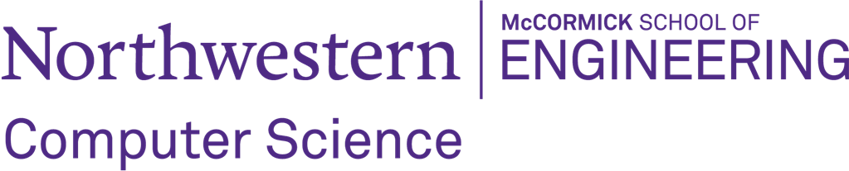
Research internship opening: Galaxy Image Deblurring
Desired Skills and Background: Image processing, Signal processing, and Machine learning
Your responsibilities in this project: 1. Reading and presenting research papers. 2. Developing code and conducting experiments. 3. Benchmarking results and summarizing key findings.
We prefer undergrad/master's students at Northwestern with an interest in computational imaging/computer vision and availability to work through the summer. Please fill out this form if you are interested. Feel free to reach out (tianaoli@u.northwestern.edu) if you have any questions/concerns.
Galaxy images captured by telescopes are degraded by nonidealities in the atmosphere, optics, and sensors. Even the most advanced telescopes produce blurs in those images, which significantly hinders our ability to discern the true shapes and structures of these galaxies. We previously addressed this challenge by developing a physics-informed deep learning method to deblur galaxy images for the Rubin Observatory (LSST), enabling more accurate shape measurements for weak lensing studies (more details here). This project pivots to address galaxies observed by space-based telescopes (e.g. JWST), where the absence of atmospheric distortion allows for high-resolution imaging for galaxy morphology studies. Our goal is to submit our discoveries to an astrophysical journal.

